Slide 1
Terrainosaurus
Terrain Generation for Dummies
Ryan Saunders
2/22/2005

Slide 2
Overview
Motivation
Current methods
Generation algorithm
All about our beautiful genetic algorithm
Problems & future work

Slide 3
Motivation
There does not currently exist a terrain generation methodology that is
  Easy to use (fractal algorithms with parameters named “octaves” and “lambda” are NOT easy to use)
  Able to be extended to generate additional types of terrain (if all you have is a hammer…)
  Based on the physical world

Slide 4
In a Perfect World…
Idealized Terrain Generation
Low amount of input required, high amount of control afforded
All user inputs intuitive
  Cryptic, free parameters are the devil
Able to produce a wide variety of recognizable types of terrain, in believable relation to each other, extensible
Arbitrary LOD
Real-time

Slide 5
Current Methods
GIS data
  Topographic maps and satellite scans
Procedural methods
  Fractals, etc.
Sculpting
  Photoshop, Bryce, Terragen
Simulation
  Erosion, plate tectonics

Slide 6

The Algorithm (1)
Create a database of GIS data, classified into logical terrain types (e.g., “Sierra Nevada mountains”, “midwest prairie”, “sand dunes”)

Slide 7
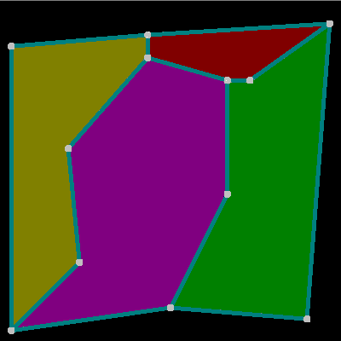
The Algorithm (2)
Create a 2D map made up of regions of terrain, specifying the size, shape and relative placement of the different terrain types

Slide 8
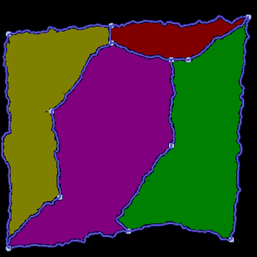
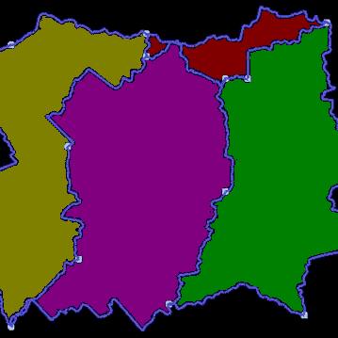
The Algorithm (3)
Refine the boundaries in this map to remove unnaturally straight lines (which would otherwise show up as artifacts in the output)
Low amount of roughness permitted
High amount of roughness permitted

Slide 9
The Algorithm (4)
Construct an initial, low-resolution heightfield by splicing together chunks of the appropriate terrain types from the terrain database

Slide 10
The Algorithm (5)
Construct progressively higher-resolution versions of the heightfield, with each successive version based on the previous
  By using the previous LOD as a rough “pattern” to approximate, we ensure that macro-level details of the heightfield are fixed before we worry about the micro-level details
We do this using a genetic algorithm that searches for an arrangement of high-resolution chunks of elevation data that:
  “fit” the shape of the lower-resolution heightfield
  display the appropriate terrain type characteristics in each region
Resample
Replace

Slide 11
Genetic Algorithms
What?
  Genetic algorithms are a family of techniques for generating approximate solutions to really difficult problems (for which the optimal solution is infeasible or unknown)
  Multiple solutions are explored simultaneously, and the more promising solutions are “cross-bred” and “mutated” to explore nearby solutions which might be better
Why?
  In this problem, we’re trying to meet two highly dissimilar constraints at the same time: terrain type characteristics and pattern geometry…and we don’t know exactly how to do that
How?
  Hold on…I’m getting there…

Slide 12
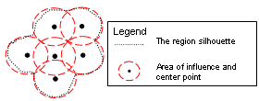
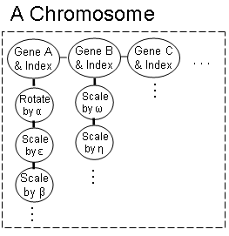
A Terrain GA
A heightfield can be represented as a chromosome containing a 2D, rectangular grid of overlapping, circular genes of a certain radius, in which each gene holds a chunk of elevation data from one of the input samples
  The genes may be mutated independently and traded between chromosomes
  When we’re done, we can turn a chromosome back into a heightfield with standard image compositing operations

Slide 13
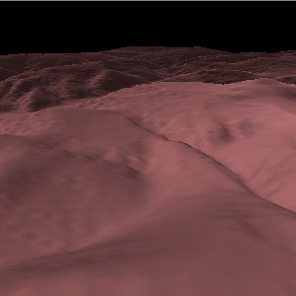
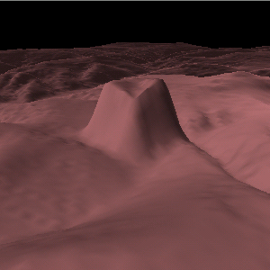
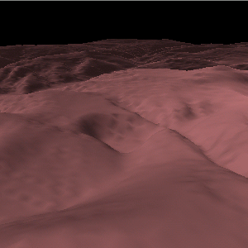
Mutating & Exchanging Genes
Just as a heightfield can be interpreted as a grayscale image (and vice versa), the mutation and crossover gene operations correspond to image manipulation operations
  The effect of these operations diminishes towards the boundary of the gene due to blending between adjacent genes
Original heightfield
Vertical offset mutation
Rotate mutation

Slide 14
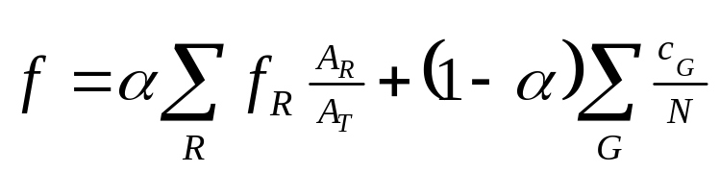
The Almighty Fitness Function
The fitness function is a scalar function returning [0,1], giving an evaluation of how “good” a particular chromosome is. Our fitness function is:
f_{R} the fitness of region R
c_{G} the compatibility of gene G with the pattern heightfield
α relative weighting factor
A_{R} area of region R
N number of genes
A_{T} total area of heightfield

Slide 15
Region Fitness
To measure the characteristics of a region of terrain, we use a number of different techniques
  Simple statistics (min, max, mean, variance) of physical quantities such as elevation and slope
  Physical features (edges, peaks, etc.) extracted with conventional computer vision techniques
  Frequency spectrum coefficients of the FFT

Slide 16
Discrimination is a good thing…really!
In order to determine which measures are most salient, we use some pattern analysis techniques
  Fisher’s Linear Discriminant (FLD) has an associated “separability” measurement. We choose the features that give the greatest separability between different terrain types as the most “discriminating” features
  Using a Forward Sequential search algorithm, we can find the N most significant features
Given this information, we can evaluate the fitness of a region in (at least) two ways
  The weighted average of the N best features, where the weights are proportional to how discriminatory each feature is
  The classification certainty of a k-Nearest-Neighbor classifier

Slide 17
The Compatibility of a Gene
Please turn your attention to the dry-erase board ☺

Slide 18
Problems / Future Work (1)
It’s not especially zippy
  Feature analysis could be significantly optimized (the feature detection algorithm I’m using is probably overkill)
  Future work: offload parallelizable code (e.g., image processing) onto the GPU
Free parameters
  Gene radius (R_{g}), evolution cycles, population size: these are all probably OK as free parameters, since they control the tradeoff between quality, computation time, and memory requirements
  Feature/geometry fitness weights (α, 1 - α): yup – this one is totally arbitrary experimentally determined
  Geometry fitness curve parameter (v): this one too, though it can probably be related to the geometry somehow

Slide 19
Problems / Future Work (2)
Bad sample terrains (or bad classification thereof) will destroy feature analysis
  Future work: computer-aided sample classification and segmentation

Slide 20
Problems / Future Work (3)
While the GA tries to ensure the right amount and scale of edges, ridges, peaks, etc., it doesn’t try to enforce physical constraints such as “rivers must flow downhill”
It would be nice, from a user standpoint, to be able to fine-tune feature placement (e.g., “I want a mountain peak here and… here.”)

